Slide 1
HAND-WRITTEN CHARACTER RECOGNITION

Slide 2
ABSTRACT
In todays’ world advancement in sophisticated scientific techniques is pushing further the limits of human outreach in various fields of technology. One such field is the field of character recognition commonly known as OCR (Optical Character Recognition).
This project is about devising an algorithm for recognition of hand written characters also known as HCR (Handwritten Character Recognition) leaving aside types of OCR that deals with recognition of computer or typewriter printed characters.

Slide 3
OBJECTIVE
In this machine learning project, we will recognize handwritten characters, that is English alphabets from A-Z. This we are going to achieve by modeling a neural network that will have to be trained over a dataset containing images of alphabets.
This project, ‘Handwritten Character Recognition’ is a software algorithm project to recognize any hand written character efficiently on computer with input is either an old optical image or currently provided through touch input, mouse or pen.

Slide 4
PURPOSE
Handwriting recognition software allows user to translate all those signature and notes into electronic words in a text document format.
HCR can be used in diverse fields like banking field where checks can be processed without human interruption and to digitize paper documents in legal industries.
Handwritten Character Recognition has various real-life time uses. It is used in the detection of vehicle number, banks for reading cheques, post offices for arranging letter, and many other tasks.
Advantage of HCR systems is that it can reduce the data entry time, storage space required by documents. Fast retrieval is an alternative advantage.

Slide 5
INTRODUCTION
The idea is to device efficient algorithms which get input in digital image format. After that it processes the image for better comparison. Then after the processed image is compared with already available set of font images. The last step gives a prediction of the character in percentage accuracy.
Optical Character Recognition uses the image processing technique to identify any character computer/typewriter printed or hand written. A lot of work has been done in this field. But a continuous improvisation of OCR techniques is being done based on the fact that algorithm must have higher accuracy of recognition, higher persistency in number of times of correct prediction and increased execution time.

Slide 6
IMPLEMENTATION
Importing Required libraries
Read Dataset
Splitting of Data
Reshaping the Training and Testing data
Creating Words Dictionary
Plotting the Number of Alphabets in the Dataset
Shuffling the Data
Reshaping the Training & Test Dataset so that it can be put in the Model
Model Creation
Compiling & Fitting Model
Getting the Train & Validation Accuracies & Losses
Predictions on Test Data
Prediction on External Image

Slide 7
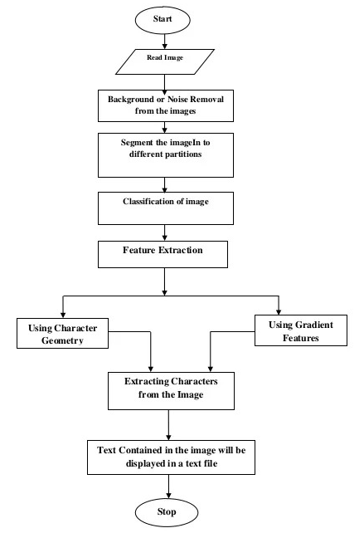
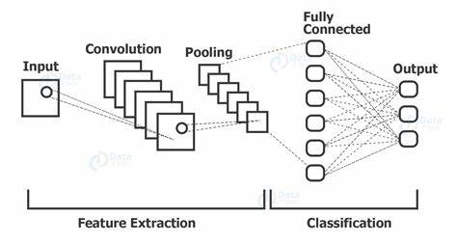
FLOWCHART

Slide 8
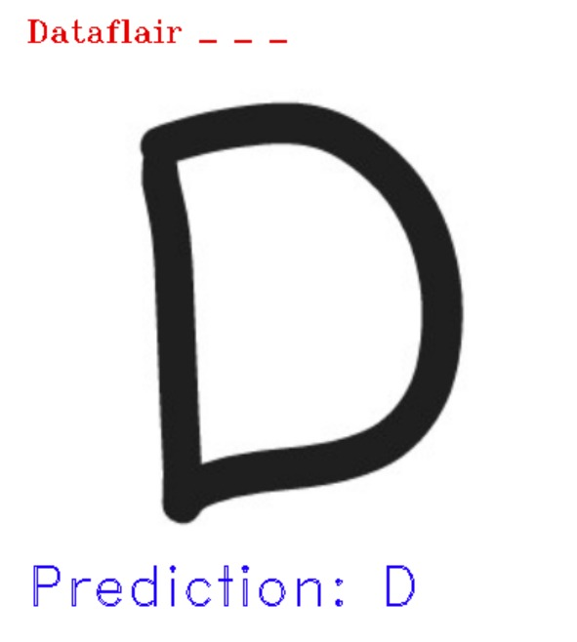
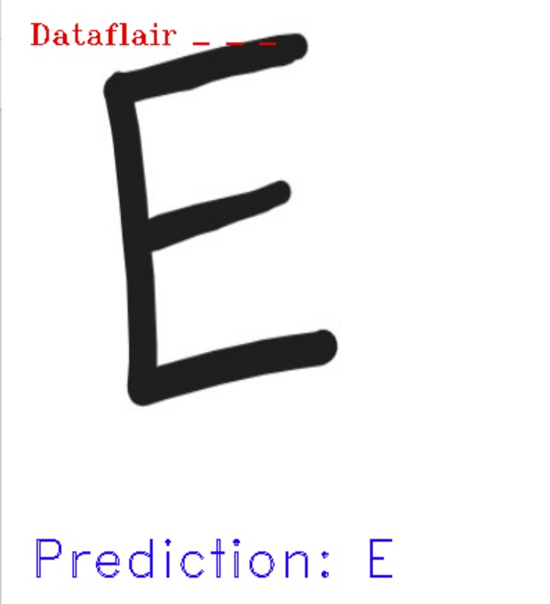
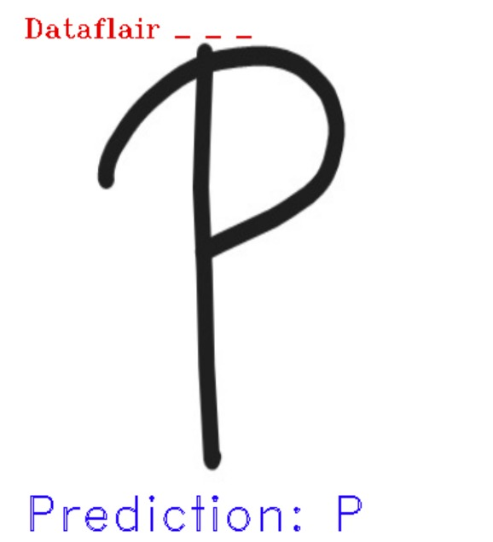
OUTPUT

Slide 9
CONCLUSION
We have successfully developed Handwritten character recognition (Text Recognition) with Python, Tensorflow, and Machine Learning libraries.
Classification of characters and learning of image processing techniques is done in this project. Also, the scheme through which project is achieved is Artificial Neural Network scheme.
Handwritten characters have been recognized with more than 97% test accuracy. This can be also further extended to identifying the handwritten characters of other languages too.

Slide 10
THANK YOU

